Slide 1

Division algorithms
Computer Organization and Architecture | Computer Arithmetic
Course: Computer Organization and Architecture | Chapter: Computer Arithmetic | Bachelor of Engineering
DISCOVER · LEARN · EMPOWER
Notes:
Welcome everyone to today's lecture on Division algorithms within Computer Arithmetic. We will explore how hardware performs division, a fundamental operation in computing. As Chandigarh University students, you are here to Discover, Learn, and Empower yourself with these core architectural concepts.

Slide 2
Course Outcomes
SLIDE 2 / 10
Course Outcome
CO | BT LEVEL | DESCRIPTION
CO1 | BT3 | Apply number systems and digital logic to design basic digital circuits
CO2 | BT4 | Analyze register organization and instruction set architecture
CO3 | BT3 | Implement computer arithmetic algorithms and floating-point operations
CO4 | BT5 | Analyze memory hierarchy and input-output organization
CO5 | BT6 | Evaluate control unit design and pipelining performance
Chandigarh University
2 / 10
Notes:
Today's lecture directly addresses Course Outcome 3. You will learn to implement specific division algorithms that are essential for floating-point operations. This skill is critical for designing efficient arithmetic logic units in modern processors.

Slide 3
Learning Objectives
SLIDE 3 / 10
Learning Outcomes
1
Define the fundamental principles of restoring and non-restoring division.
2
Analyze the step-by-step execution of restoring division algorithm.
3
Compare the efficiency of non-restoring division against restoring methods.
4
Evaluate the hardware requirements for implementing division circuits.
Chandigarh University
3 / 10
Notes:
By the end of this session, you will be able to define and analyze these algorithms. We will compare their efficiency to understand why non-restoring division is often preferred. Finally, we will evaluate the specific hardware needs for each method.

Slide 4
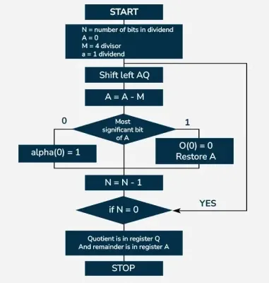
Lecture
SLIDE 4 / 10
Restoring Division Principle
1
Subtract divisor from partial remainder to determine quotient bit.
2
If result is negative, restore the previous remainder value.
3
Shift the remainder left and append the quotient bit.
4
Repeat process until all bits of the dividend are processed.
5
Ensures the partial remainder never drops below zero permanently.
Restoring Division Algorithm For Unsigned Integer - GeeksforGeeks
Chandigarh University
4 / 10
Notes:
The restoring division algorithm works by attempting subtraction at each step. If the result is negative, we must add the divisor back to restore the value before shifting. For example, if 5 minus 8 is negative, we restore 5 before proceeding.

Slide 5
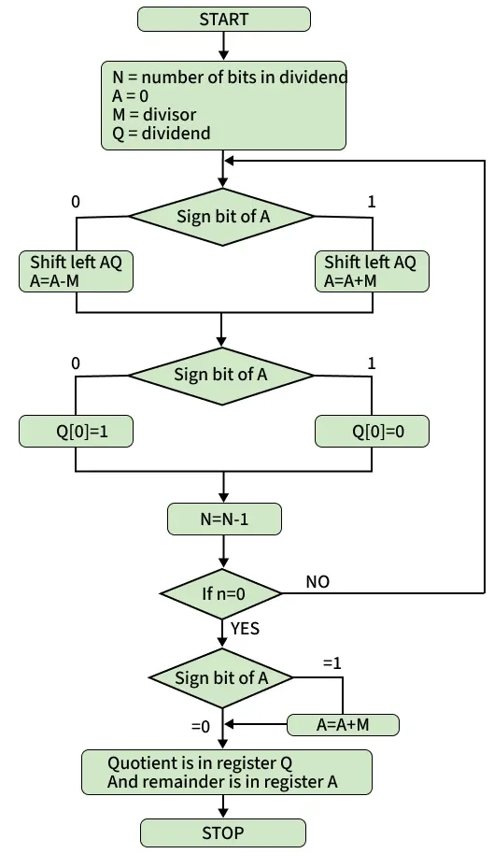
Lecture
SLIDE 5 / 10
Non-Restoring Division Logic
1
Skip the restoration step if the partial remainder is negative.
2
Add the divisor if the remainder is negative in next step.
3
Subtract the divisor if the remainder is positive in next step.
4
Shift the remainder left regardless of the sign at each step.
5
Final correction is applied only after all bits are processed.
Source: media.geeksforgeeks.org
Chandigarh University
5 / 10
Notes:
Non-restoring division improves speed by skipping the restoration step. If the remainder is negative, we simply add the divisor in the next iteration instead of restoring immediately. This reduces the number of operations required per bit.

Slide 6
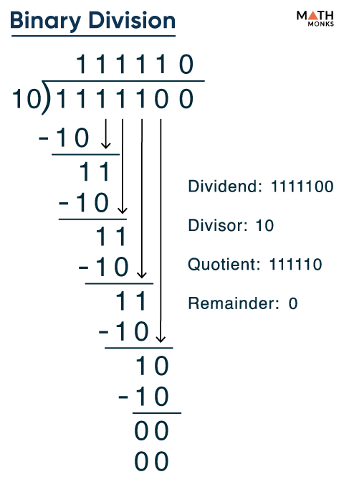
Worked Example
SLIDE 6 / 10
Restoring
INITIAL STEP
Subtract 3 from 10 to get 7.
SECOND STEP
Shift 7 left to 14, subtract 3 to get 11.
THIRD STEP
Shift 11 left to 22, subtract 3 to get 19.
• Dividend 1010 (10) divided by Divisor 0011 (3).
• Final quotient is 0011 (3) with remainder 0001 (1).
Source: mathmonks.com
Chandigarh University
6 / 10
Notes:
Let us work through dividing 10 by 3 using binary. We start by subtracting 3 from 10, getting 7. We then shift and subtract repeatedly. The final quotient is 3 with a remainder of 1, confirming our calculation.

Slide 7
Worked Example
SLIDE 7 / 10
Non-Restoring
STEP 1
Subtract 3 from 10 to get 7 (positive).
STEP 2
Shift 7 to 14, subtract 3 to get 11 (positive).
STEP 3
Shift 11 to 22, subtract 3 to get 19 (positive).
• Dividend 1010 (10) divided by Divisor 0011 (3).
• Final quotient is 0011 (3) with remainder 0001 (1).
Source: media.geeksforgeeks.org
Chandigarh University
7 / 10
Notes:
Using non-restoring logic on the same numbers yields the same result. We perform subtractions and shifts without restoring intermediate negative values. This example demonstrates how the algorithm maintains correctness while saving time.

Slide 8
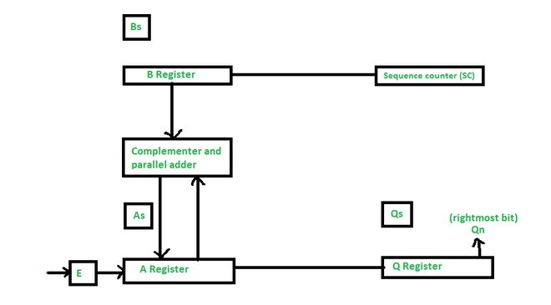
Lecture
SLIDE 8 / 10
Hardware Implementation
1
Requires an n-bit adder, n-bit shifter, and n-bit register.
2
Control logic determines add or subtract operations at each step.
3
Quotient register shifts left to store the result bits.
4
Restoring method needs extra adder for restoration steps.
5
Non-restoring method simplifies control logic for faster execution.
Source: media.geeksforgeeks.org
Chandigarh University
8 / 10
Notes:
The hardware implementation relies on an adder, a shifter, and registers. Restoring division requires an extra adder to handle the restoration steps. Non-restoring division simplifies the control logic, making it faster and more efficient for hardware design.

Slide 9
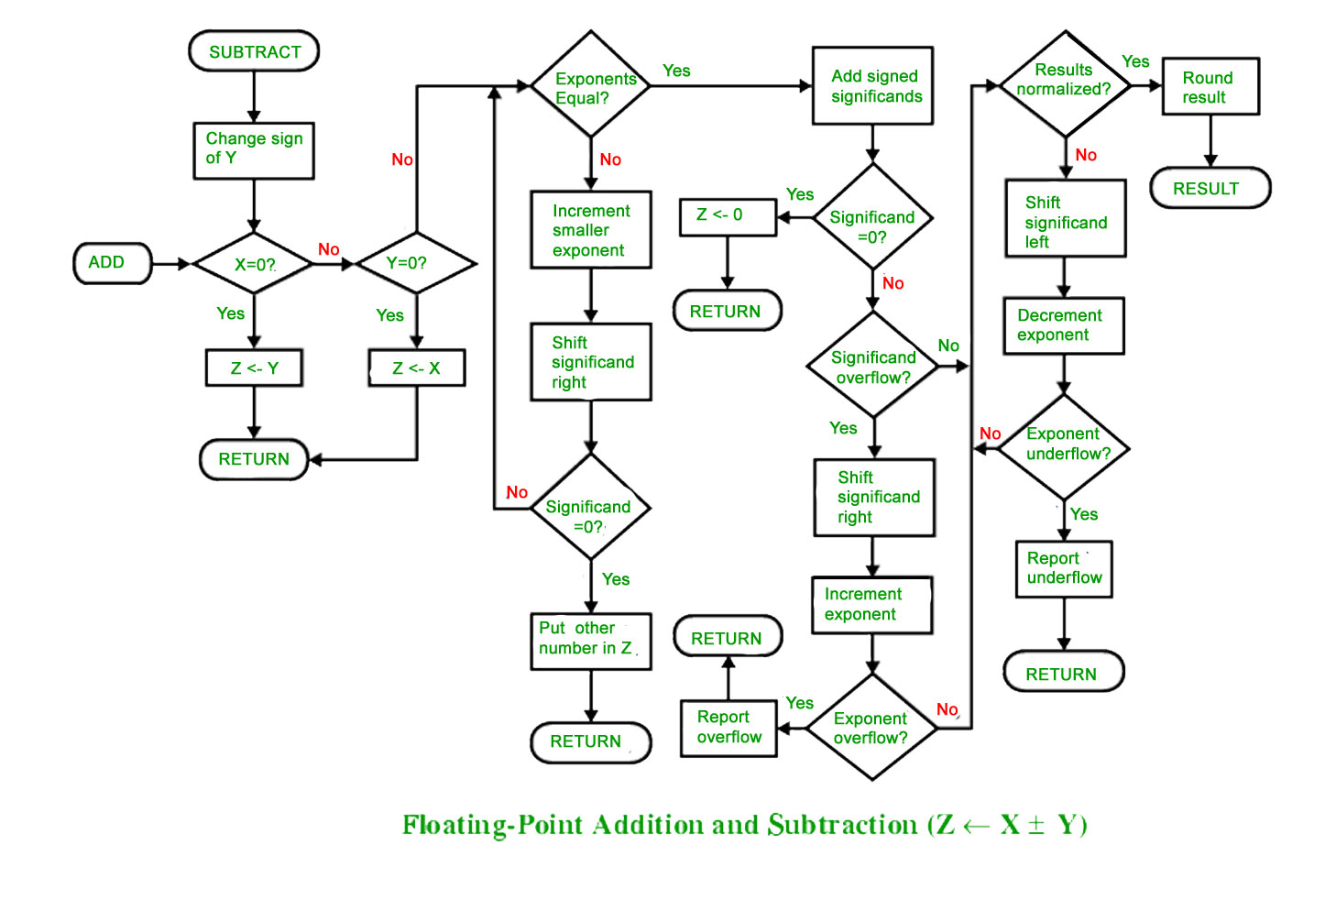
Lecture
SLIDE 9 / 10
Key Takeaways
1
Restoring division corrects negative remainders by adding the divisor.
2
Non-restoring division skips restoration for improved speed and efficiency.
3
Both algorithms produce the same quotient and remainder results.
4
Hardware complexity is reduced in non-restoring division designs.
5
Understanding these algorithms is vital for CO3 implementation goals.
Source: media.geeksforgeeks.org
Chandigarh University
9 / 10
Notes:
To summarize, restoring division corrects errors by adding back the divisor. Non-restoring division skips this step for better performance. Both methods are essential for implementing computer arithmetic algorithms as required by our course outcomes.

Slide 10
Lecture
SLIDE 10 / 10
References
COMPUTER ORGANIZATION AND DESIGN
The Hardware/Software Interface — David A. Patterson, John L. Hennessy
COMPUTER ARCHITECTURE
A Quantitative Approach — John L. Hennessy, David A. Patterson
• Computer Organization and Architecture — William Stallings
• Computer System Architecture — M. Morris Mano & Rajib Mall
• Computer Organization — Carl Hamacher, Zvonko Vranesic, Safwat Zaky
Chandigarh University
10 / 10
Notes:
These five textbooks provide the foundational knowledge for today's lecture. Please refer to Stallings and Mano for detailed algorithmic explanations. Hennessy and Patterson offer excellent insights into hardware implementation and quantitative analysis.

